Slide 1


Spring Cloud
Routing - API Gateway, Distributed tracing - Zipkin and Sleuth

Slide 2


Agenda
1) Routing - API Gateway
2) Distributed tracing - Zipkin and Sleuth

Slide 3
Routing - API Gateway
Spring Cloud Gateway matches routes using the Spring WebFlux HandlerMapping infrastructure.
It also includes many built-in Route Predicate Factories. All of these predicates match different attributes of the HTTP request. Multiple Route Predicate Factories can be combined via the logical “a

Slide 4
Modules In Maintenance Mode
Placing a module in maintenance mode means that the Spring Cloud team will no longer be adding new features to the module. We will fix blocker bugs and security issues, and we will also consider and review small pull requests from the community.
We intend to continue to support these modules for a period of at least a year from the general availability of the Greenwich release train.
The following Spring Cloud Netflix modules and corresponding starters will be placed into maintenance mode:
spring-cloud-netflix-archaius
spring-cloud-netflix-hystrix-contract
spring-cloud-netflix-hystrix-dashboard
spring-cloud-netflix-hystrix-stream
spring-cloud-netflix-hystrix
spring-cloud-netflix-ribbon
spring-cloud-netflix-turbine-stream
spring-cloud-netflix-turbine
spring-cloud-netflix-zuul

Slide 5
Zuul is a blocking API. A blocking gateway api makes use of as many threads as the number of incoming requests.
So this approach is more resource intensive. If no threads are available to process incoming request then the request has to wait in queue. In this tutorial we will be implementing API Gateway using Spring Cloud Gateway.
Spring Cloud Gateway is a non blocking API. When using non blocking API, a thread is always available to process the incoming request.
These request are then processed asynchronously in the background and once completed the response is returned. So no incoming request never gets blocked when using Spring Cloud Gateway.

Slide 6
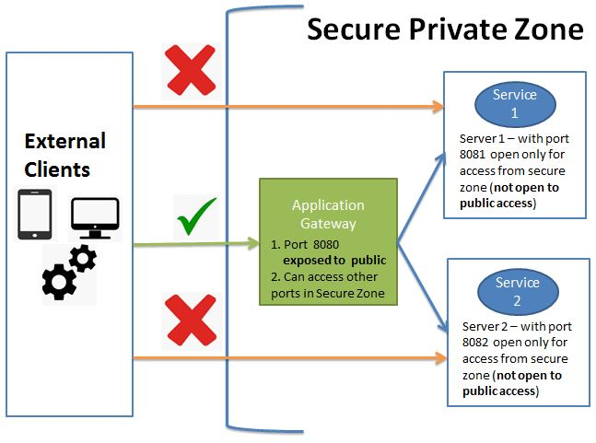
What is an API Gateway? Why do we need it?
An API Gateway acts as a single entry point for a collection of microservices. Any external client cannot access the microservices directly but can access them only through the application gateway In a real world scenario an external client can be any one of the three-Mobile Application
Desktop Application
External Services or third party Apps

Slide 7
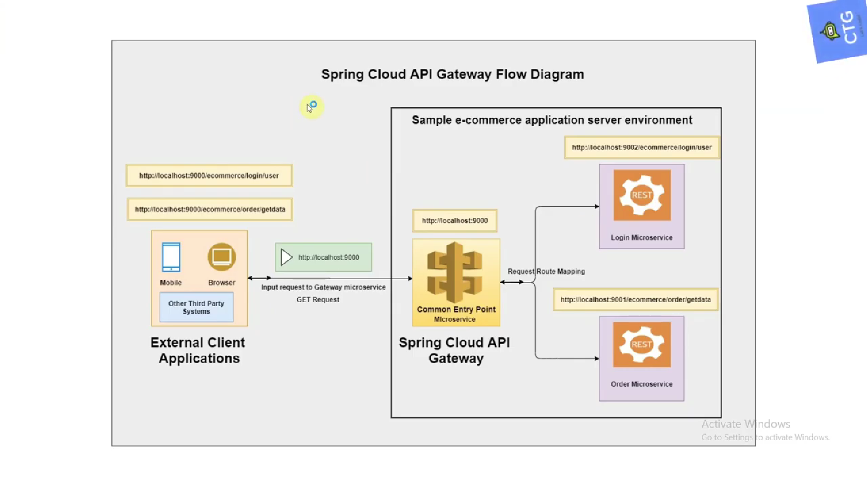

Slide 8
The advantages of this approach are as follows-This improves the security of the microservices as we limit the access of external calls to all our services.
The cross cutting concerns like authentication, monitoring/metrics, and resiliency will be needed to be implemented only in the API Gateway as all our calls will be routed through it.
The client does not know about the internal architecture of our microservices system. Client will not be able to determine the location of the microservice instances.
Simplifies client interaction as he will need to access only a single service for all the requirements.

Slide 9
Spring Cloud Gateway Architecture
Spring Cloud Gateway is API Gateway implementation by Spring Cloud team on top of Spring reactive ecosystem. It consists of the following building blocks-Route: Route the basic building block of the gateway. It consists of
ID
destination URI
Collection of predicates and a collection of filters
A route is matched if aggregate predicate is true.
Predicate: This is similar to Java 8 Function Predicate. Using this functionality we can match HTTP request, such as headers , url, cookies or parameters.
Filter: These are instances Spring Framework GatewayFilter. Using this we can modify the request or response as per the requirement.

Slide 10
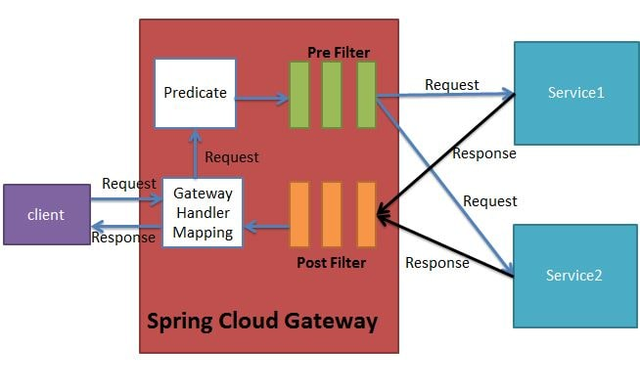

Slide 11
Distributed tracing - Zipkin and Sleuth

Slide 12
Sleuth is another tool from the Spring cloud family. It is used to generate the trace id, span id and add this information to the service calls in the headers and MDC, so that It can be used by tools like Zipkin and ELK etc. to store, index and process log files.

Slide 13
What is zipkin?
Zipkin is a Java-based distributed tracing system to collect and look up data from distributed systems. Too many things could happen when a request to an HTTP application is made. A request could include a call to a database engine, to a cache server, or any other dependency like another microservice.
What is sleuth in microservices?
Spring Cloud Sleuth is meant to help with this exact problem. It introduces unique IDs to your logging which are consistent between microservice calls which makes it possible to find how a single request travels from one microservice to the next.

Slide 14
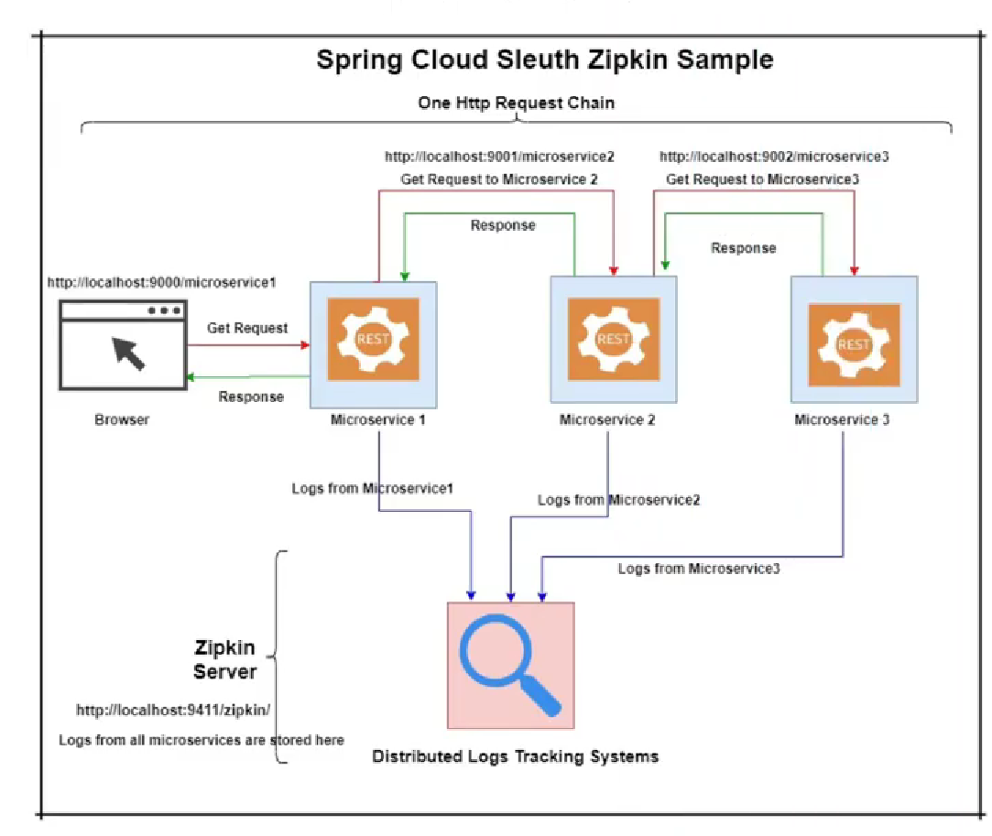

Slide 15
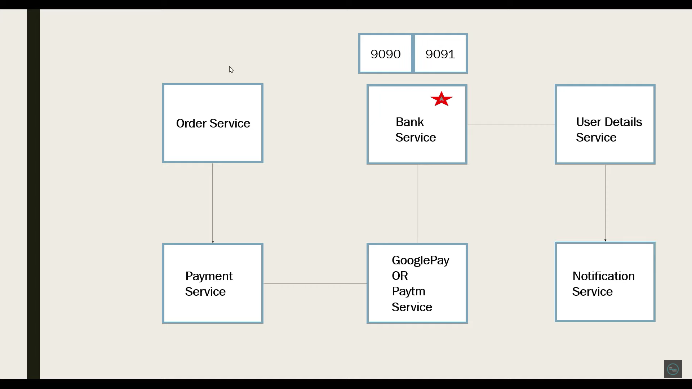

Slide 16
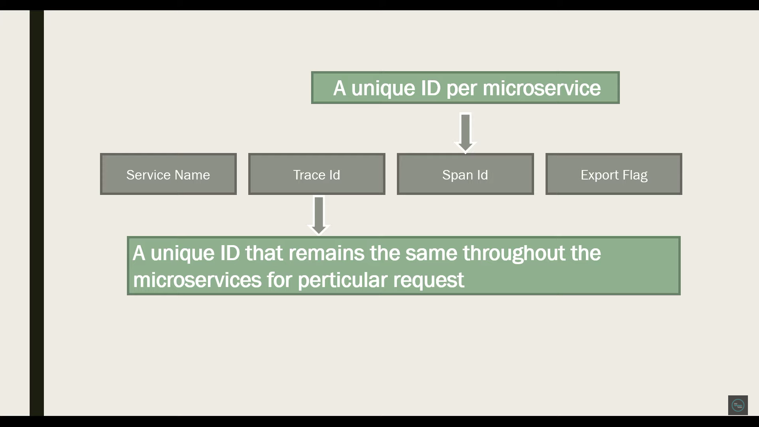

Slide 17
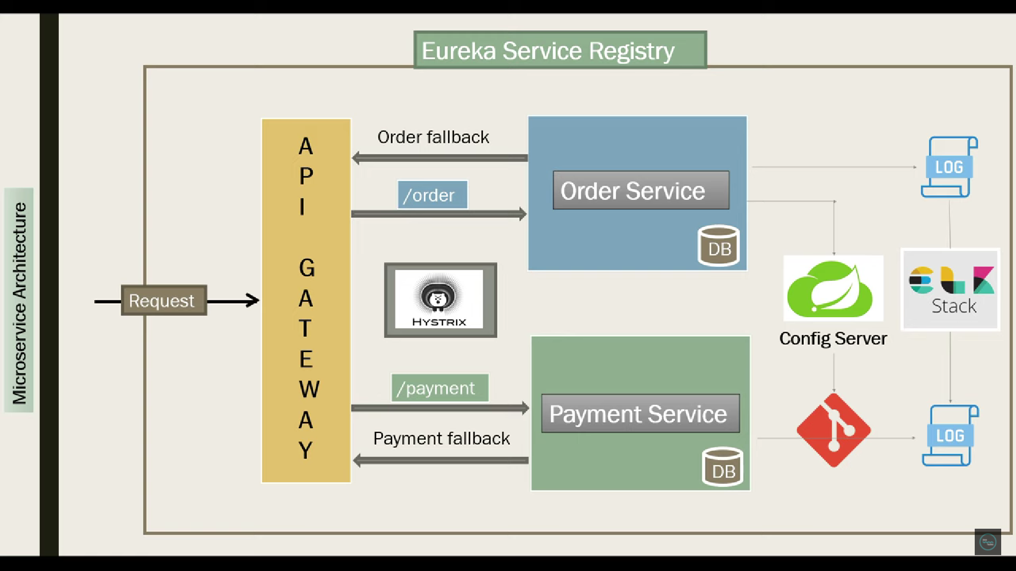

Slide 18
